Slide 1
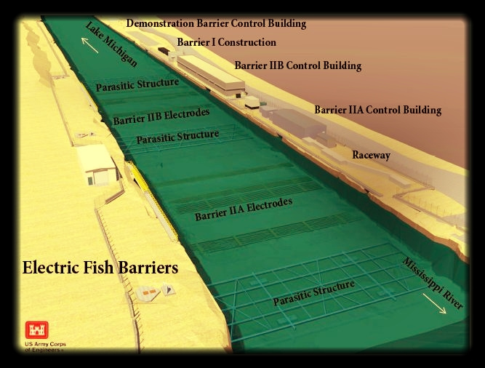
Recently I saw a YouTube video that explained how the US is blocking an invasive fish species to enter the Great Lakes (GL).
A canal many electric barriers (21 ft below surface) . What is uncertain is which barrier is going to need maintenance. I think it is a stochastic process because the canal should remain electrified to block the entrance of invasive fish to GL, however the barrier also need maintenance. There is randomness in which barrier will need maintenance, and how to better maintain the barriers in order to keep the canal electrified.
Source: https://www.youtube.com/watch?v=t3oLeSPINOk

